Slide 1
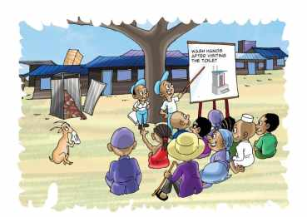
Water Sector Trust Fund SOCIAL MARKETING
3. The Social Animators (Sanitation Marketers)
- Responsibilities & Tools -
people, place, product, price, participation, promotion, policy, programs, positioning, partnerships, poo, pee

Slide 2
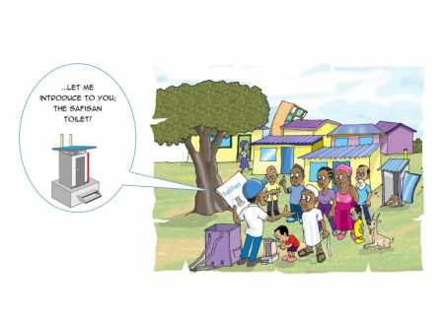
UBSUP Social marketing: Social Animators
Are recruited and managed by the WSP
Are part of the project task team ( if constituted by the WSP)
Participate in town & area level activities (Barazas, etc.)
Responsible for plot & household level marketing visits

Slide 3
UBSUP Social marketing: Social Animators
Key roles of the Social Animators (Sanitation Marketers):
Create demand for improved sanitation (SafiSan Toilets)
Making sure residents get to know the different SafiSan toilets, their advantages, costs, and where and how to get one
It’s about explaining the what, why, when, where and how
Promote good hand washing and hygiene practices
Create awareness on the sanitation value chain

Slide 4
UBSUP Social marketing: 6 key messages
Access to adequate sanitation is a human right
Benefits of improved sanitation (better toilets)
Advantages of the SafiSan toilets
Importance of using the toilet properly, keeping the toilet clean and in good condition
Importance of hand washing especially after using the toilet (to kill germs & reduce the risk of diseases)
Importance of emptying, transport & decentralised treatment (if applicable)

Slide 5
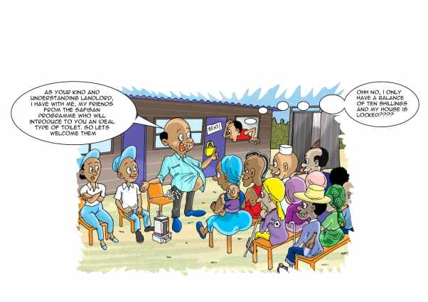
UBSUP Social marketing: Main Activities of Social Animators
See the Social Animator Handbook PART 3:
No. 11 (page 93)
No. 12 (page 94)
No. 12b (page 95)
No. 12c (page 96)

Slide 6
UBSUP Social marketing: Key Tools of Social Animators
The Social Animators Handbook
The SafiSan toilets sales posters
Demonstration scale models of SafiSan toilets
The SafiSan Baraza Show tools
The hand washing posters & comic book (for children)
The toilet use manual
The (full-size) demonstration toilets and toilet use demonstration video
Brochures, banners and flyers
Android tablet ( which contains the SafisApp used for registration)

Slide 7
Social marketing: Additional Tools
Other tools used by the Social Animators:
Overall programme for community sensitisation
Messages for Chiefs, PHOs & opinion leaders for use in public meetings
SafiSan song & skit
School WASH programme materials (on hand washing)
Data collection questionnaire to measure customer satisfaction
MajiData (www.majidata.go.ke)
Visibility:
Mascot, slogan, rider
Baseball cap, t-shirt, sticker
Bag and the other items that make up the Social Animators’ kit

Slide 8
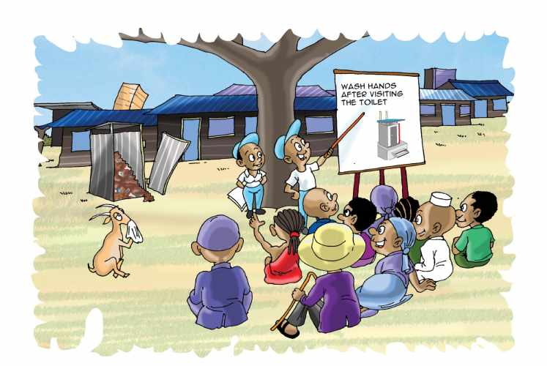
Thank You!

